Slide 1
The Potential Disasters and Hazards at the Jefferson Oil Drilling Site In South Los Angeles, and The Conceivable Implications of Chronic Stress for Surrounding Residents
Marissa Chan
Summer 2015

Slide 2
Research Topic: Jefferson Drill Site
Potential disasters that could occur at the Jefferson Drill site in South Los Angeles
Synthesized literature on the mental and physical health effects from Chronic Technological Disasters (CTD’s)
Research Question: Urban populations living close to oil fields face the constant threat of disaster, what are the potential disasters that can occur at the Jefferson oil drilling site and how can an environmental justice community potentially be affected by chronic stress from the continuous threat of a disaster?
Notes:
Jefferson is one of three drill sites on the Las Cienegas Oil Field
The Oil drilling site is

Slide 3
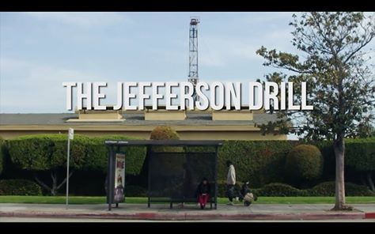
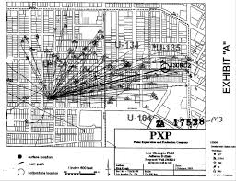

Slide 4
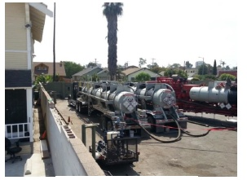

Slide 5
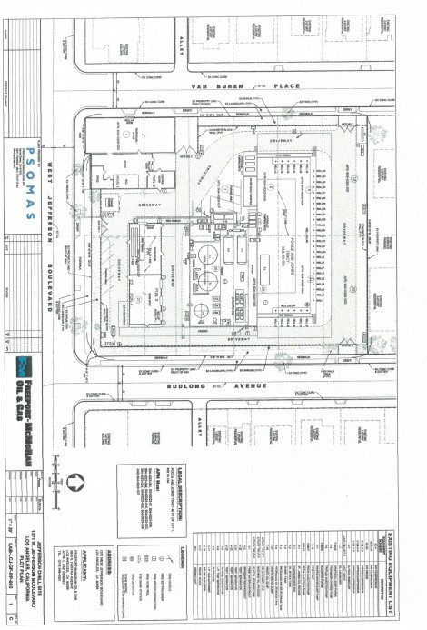

Slide 6
Why Urban Oil Drilling?
Impacts environmental justice communities that are disproportionally burdened by multiple stressors
The shift from conventional to unconventional oil extraction makes this practice extremely risky and dangerous
Many sites have not conducted Environmental Impact Reports making the potential disasters and consequences unknown

Slide 7
Challenges and Opportunities
The lack of information regarding conceivable disasters
Could not conduct interviews due to time restrictions
Attended multiple STAND-LA Coalition meetings as well as South Coast Air Quality Management District Meetings
Work with Isha an exchange student from HKUST

Slide 8
Methods
Used the Hermosa Beach Environmental Impact Report to find disasters that could potentially occur at Jefferson
Used Geographic Information Systems (GIS) to map a radius around the site to show where serious injuries and fatalities could occur(scenarios 1-3)
Used MARPLOT and ALOHA systems to map scenarios 4-6
Compiled 4 potential hazards that could not be mapped
Synthesized literature on CTD’s

Slide 9
Scenarios 1-3
Scenario 1 involves a rupture of the drilling equipment upstream of the gas gathering system and would be caused by failures in piping, valve breaks, vessel failures, or high pressure “kicks”. The consequences are toxic, flame jets, and flammable vapor clouds
Scenario 2 involves a rupture of the gas equipment at the wellheads during production, and would be caused by failures in piping, valve breaks, vessel failures, or “kicks” from high pressure. The consequences are toxic, flame jets, and flammable vapor clouds
Scenario 3 involves a loss of oil from the oil storage tank and an ignition or fire. The consequences are a large crude oil fire and thermal radiation.

Slide 10
Scenarios 4-6
Scenario 4 involves an accident on Van Buren Place in front of Gate 3. This scenario involves a tanker truck 6’ x 23.6’ holding around 4,917 gallons of hydrochloric acid which becomes hydrogen chloride vapors when released. The consequences are toxic hydrogen chloride vapors.
Scenario 5 mimics scenario 4 except it involves an accident on Budlong Avenue in front of gate 4. The consequences are toxic hydrogen chloride vapors.
Scenario 6 follows the previous two scenarios except an accident occurs that results in a puncture to the tank while it is stored on site for acidizing. The tanks are stored next to the houses on the north side of the site. The consequences are toxic hydrogen chloride vapors.

Slide 11
Potential Hazards
An oil spill from the oil storage tank and the proximity to catch basins
Produced water in the waste water sump and injection wells
Diesel emissions from trucks and work overloads
The collection of oil in the well cellar.

Slide 12
Scenarios (Injury) Approximate distances | Toxic | Overpressure | Vapor Cloud | Fire/Thermal
Scenario 1 | 25 feet | 760 feet | 398 feet | 209 feet
Scenario 2 | 25 feet | 550 feet | 265 feet | 190 feet
Scenario 3 | ---- | ---- | ---- | 145 feet
Scenarios (Fatality) Approximate distances | Toxic | Overpressure | Vapor Cloud | Fire/Thermal
Scenario 1 | ---- | 298 feet | 149 feet | 152 feet
Scenario 2 | ---- | 215 feet | 97 feet | 140 feet
Scenario 3 | ---- | ---- | ---- | 90 feet
Results:
Scenarios (Injury) Population within the buffer | Toxic | Overpressure | Vapor Cloud | Fire/Thermal
Scenario 1 | Contained within the site | 1765.42 | 479.69 | 112.1
Scenario 2 | Contained within the site | 913.53 | 197.29 | 90
Scenario 3 | ---- | ---- | ---- | 3
Scenarios (Fatality) Population within the buffer | Toxic | Overpressure | Vapor Cloud | Fire/Thermal
Scenario 1 | ---- | 256.88 | 51.23 | 52.6
Scenario 2 | ---- | 120.7 | 14.3 | 42.67
Scenario 3 | ---- | ---- | ---- | Contained within the site

Slide 13
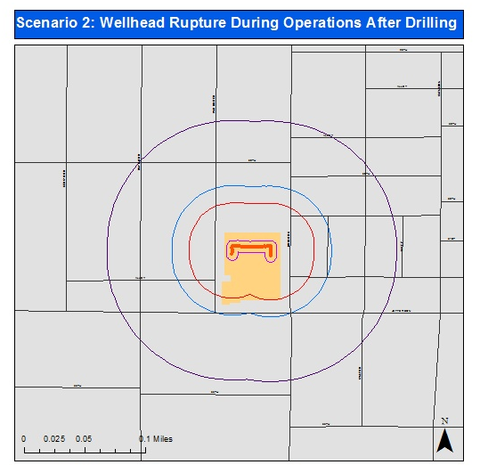
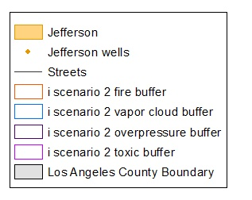

Slide 14
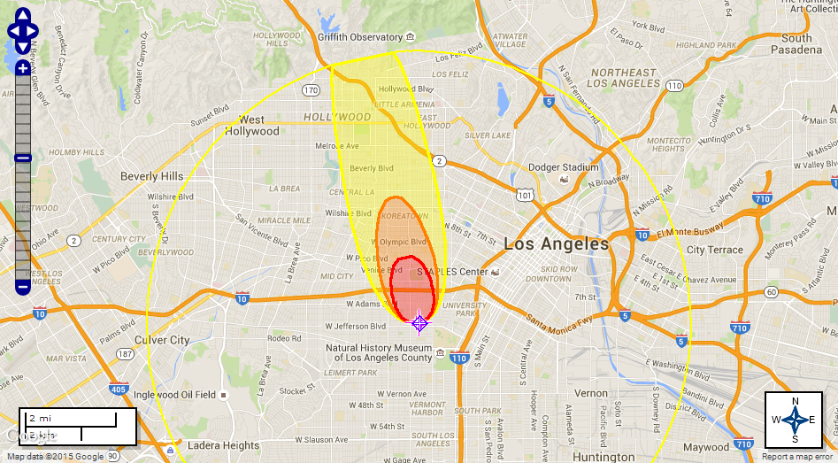
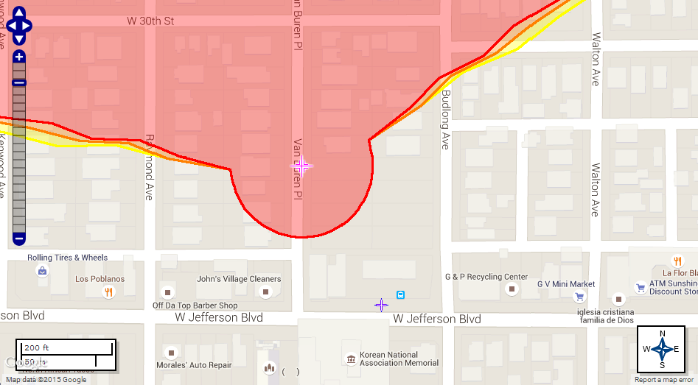
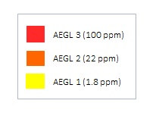
Scenario 4: Spill on Van Buren Place
Less than 100 ppm of HCL can cause swelling of the lungs and throat spasms
35 ppm of hydrogen chloride is found to cause irritation of the throat, coughing, and it may also lead to breathing difficulties and skin inflammation
Less than 5 ppm of HCL can cause coughing in certain populations

Slide 15
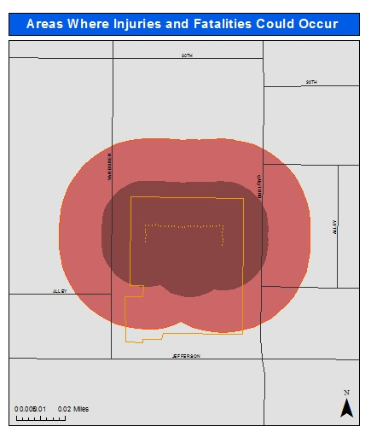
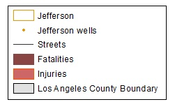
Areas where serious injury and fatalities are likely to occur

Slide 16
Chronic Technological Disasters
Chronic technological disasters (CTD’s) occur when there is a breakdown in equipment or a human error that results in the contamination of the natural or built environment
No literature on oil drilling sites and the potential chronic stress to residents caused by a CTD
CTD’s can have serious mental and physical health effects that are persistent and do not follow the typical disaster cycle

Slide 18
Conclusions
Need for a 1,500 foot buffer between oil activity and sensitive land uses.
Research should be conducted on the chronic stress of residents living near oil drilling sites.
There is also a need for environmental justice screening methods to include chronic stress as an area measure.
There needs to be a change in the regulation and permitting of oil drilling to ensure that public health comes before corporate profit.

Slide 19
Experiences
Introduced to urban oil drilling issues in Los Angeles and community based research
Went to the STAND LA and SCAQMD meetings
Discussions regarding the environment, college, and current issues in both Los Angeles and Hong Kong
Interesting to see the similarities and differences between our experiences in college and the cities where we live

Slide 20
What now?
Internship with Esperanza Community Housing this semester which has allowed me to continue my summer work
Working on the People Not Pozo’s Campaign (Allenco Site)
Community organizers at the Jefferson drill site are posting my maps on their website as well as potentially using the maps for future campaigns

Slide 21
The End!
I’d like to thanks Professor Shamasunder, Professor Foong, and Professor Sadd for their help and support throughout the summer, and Physicians for Social Responsibility LA for funding

