Slide 1
Case Study of Oil Drilling in Urban Cities
Student Researcher: Isha Chaturvedi, Supervisor: Prof Bhavna Shamasunder
Occidental College, UEPI
1
Research Results
2
Introduction
Urban Oil Drilling is an Environmental Justice Issue.
It affects the low-income communities and further deteriorates their condition.
Drilling has affected the land prices, as it leads the land to be devoid of any nutrients.
Oil drilling in the middle of urban communities magnifies the potential damage due to high population density: Drilling sites are subjected to high seismic activities.
Drilling sites have reported presence of hazardous chemicals in the water, and toxins in the air
Today, Oil Industry is not able to balance the falling oil production with its high demand due to depleting oil quantities in existing sources, and so there is a rapid increase in drilling activities in the urban areas, as companies are finding any feasible place to tap the oil potential.
Oil Drilling, which was once restrained to only rural areas, has now not even spared urban areas. In many cases, companies are able to re-open old wells after decades of inactivity without obtaining a new permit or notifying nearby residents.
Urban Oil Drilling is a new concept today, in the sense that the companies have started to look in to the possibility of drilling in urban area, to combat the increasing demand of oil and depleting oil quantities in the existing sources.
Moreover even if the oil drilling in urban existed from long, a whole lot of population is unaware about its existence. Due to the rapid urbanization, and increasing population, more and more cities are falling into the urban oil drilling category.
Objective
The research studies urban oil drilling in four locations around the world: Los Angeles (California), Houston (Texas) in US, London (UK), Mumbai (India), where drilling is contested by social movements
The four cities are analyzed and compared, based on the above factors: location of the oil fields, impact on the community, which includes health impact and socio-economic impacts, type of community living nearby the oilfields, response of the communities living nearby, the impacts on the environment including water, air and land, and response of the Oil Industry and Government to the issues raised up due to urban oil drilling.

Slide 2
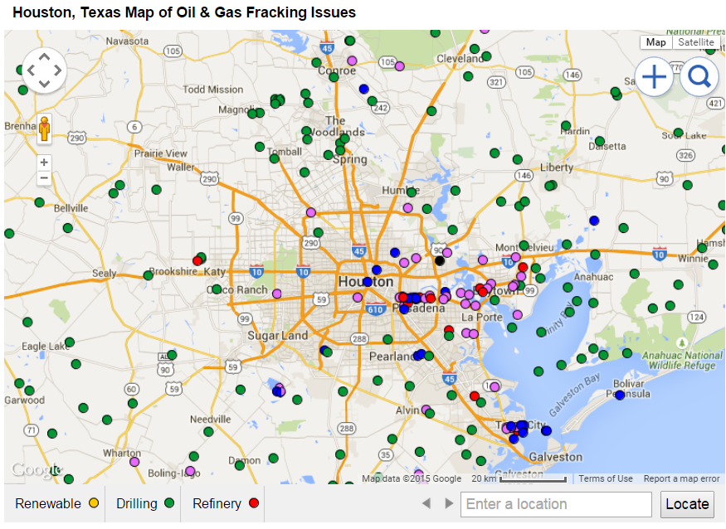
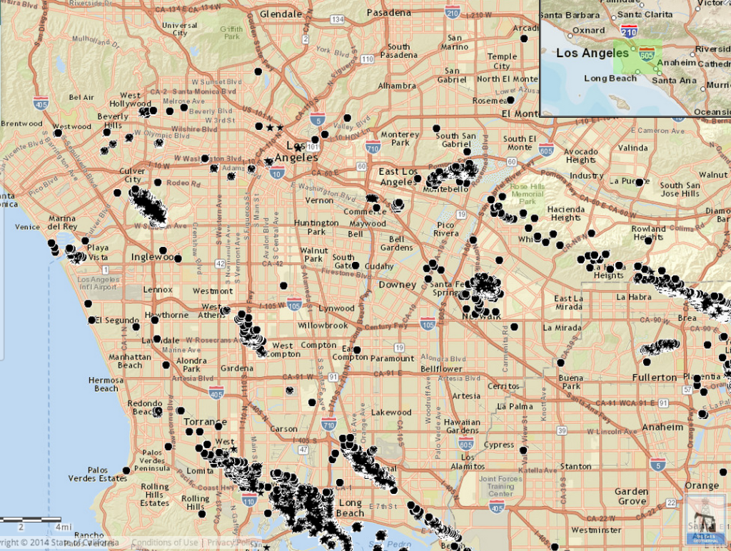
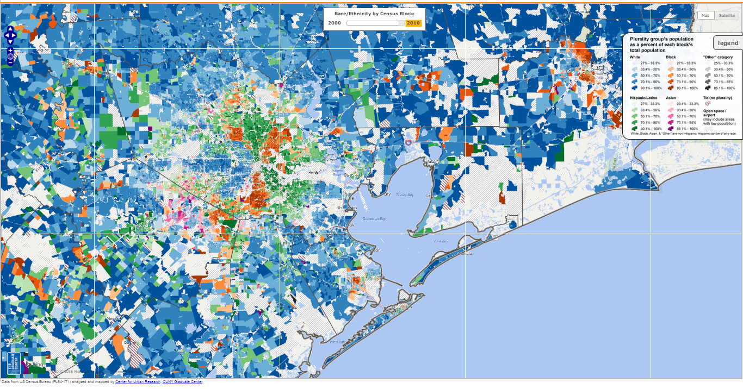
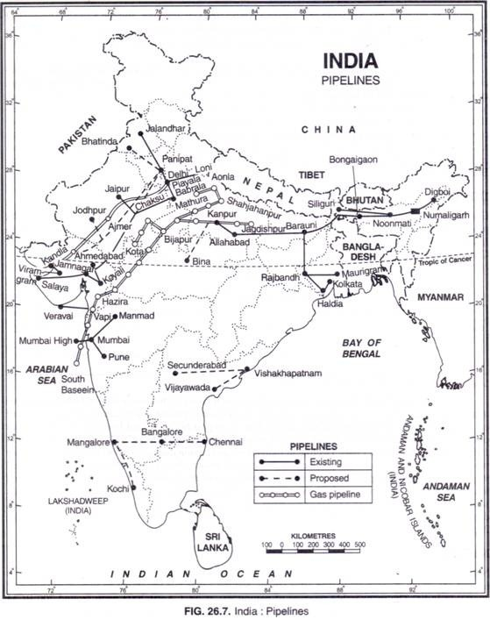
3
Los Angeles, US
Los Angeles sits directly atop the nation’s largest urban oil field.
70% of the 5,194 active oil wells in LA are located within 1500 feet of sensitive land use areas like homes, schools, and hospitals.
Sixty-seven percent of Angelinos who live within a quarter mile of an oil or gas well are Hispanic/Latino, and these communities often struggle with the negative health impacts of air pollution and toxic waste.
Main Companies in Operation: Freeport McMoran Oil & Gas, AllenCo, Plain All American
4
Houston, US
The Oil Production statistics showed that there has been 85% decrease in Oil Production in last 22 years with the increase in number of drilling Permits approved.
According to a survey released in January by the Texas Alliance of Energy Producers, (a group supported by the state's energy industry) 83% percent of respondents said they would be in favour of oil or natural gas drilling on their land if they were paid for it.
Blue Dots = Oil & Gas Health or Safety Issue Reported, Purple Dots = Power Plant (Source: DrillingMaps.com )
It is home to the largest concentration of refineries and petrochemical plants in the world.
Map of active oil and gas wells in Los Angeles (Source: DOGGR)
Race/Ethnicity Trends in Houston, Texas 2010 (Source: Centre for Urban Research)
5
Mumbai, India
6
London, UK
In Mumbai, oil drilling and spills have affected the aquatic ecosystem.
The All Maharashtra Fisherman Association has accused the Oil and Natural Gas Corporation (ONGC) of their continuous seismic activities which impairs the hearing abilities of fish, which eventually leads to their death.
For the past five months, fishermen have been suffering heavily due to the insufficient catch.
The association wants the oil company to compensate the fishermen with about 800 thousand dollars.
Companies in Operation: Oil & Natural Gas Corporation (ONGC), Hindustan Petroleum Corporation Limited (HPCL)
In October 2014, London Local Energy (LLE) applied to Department of Energy and Climate Change (DECC) under the 14th License Round for an onshore exploration license in the areas of North, West and Central London.
Similarly another British energy company UK Oil & Gas Investments have found 8 billion barrels of shale oil in London’s commuter belt near the Gatwick Airport, nations second busiest airport.
This land lies in an environmentally sensitive area, having National Parks, Areas of Outstanding Natural Beauty.
So far a thousand of people have signed petition against LLE’s projected plan.
Due to already present awareness among the people in London, public acceptance is the biggest obstacle for the operations
LLE and the mayor believe that Londoners can protect rural areas by responsibly using the energy under our own.
Oil and Gas Pipelines in India
(Source: YourArticleLibrary.com)
Contact Details :
Isha Chaturvedi : ichaturvedi@stu.ust.hk; Prof Bhavna Shamasunder : bhavna@oxy.edu

