Slide 1
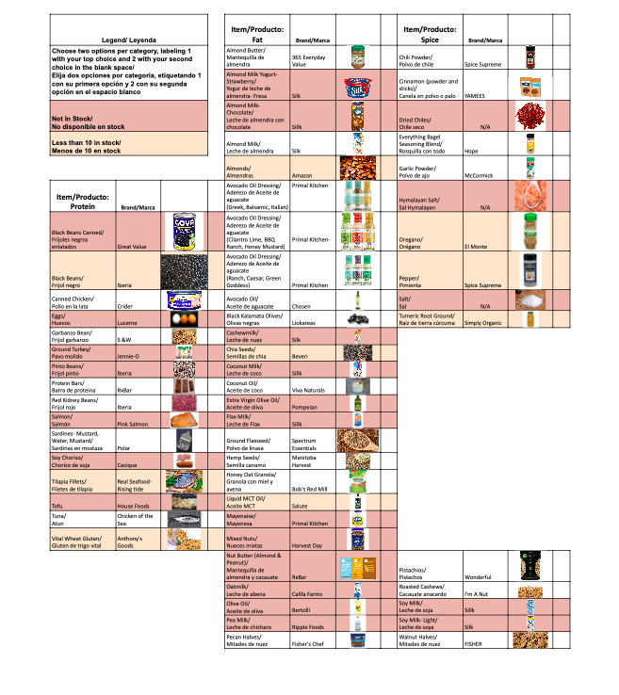
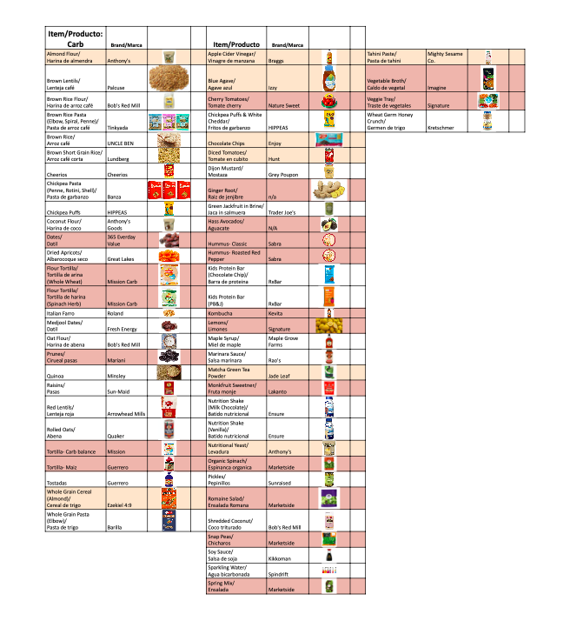
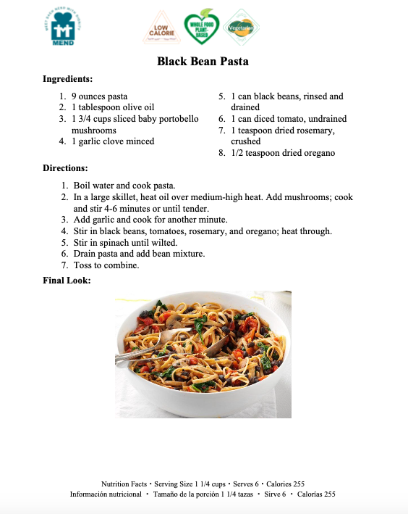
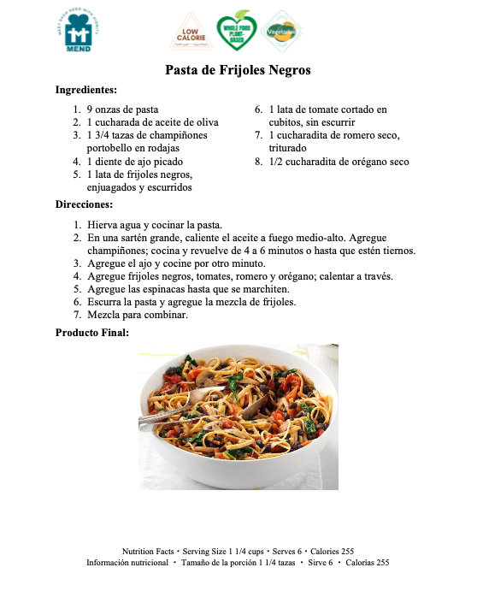
Meet Each Need with Dignity (MEND)- Wellness Program
Janet Orozco, Occidental College | Jessica Martinez, Wellness Program Coordinator
Background
II. Methods
III. Results
Figure 2 – New organizational system for MEND Supplemental Foods.
Meet Each Need with Dignity (MEND) began in 1971 in a garage. It has grown to become an anchor institution with the largest food bank in the San Fernando Valley. It provides clothing, homeless care services, and support through case management for individuals and families in need. Their mission statement declares, “With dignity and respect, MEND’s mission is to meet immediate needs of individuals and families and increase their access to opportunities that strengthen their capacity to thrive.” MEND is unique in that it is 99% volunteer driven and nearly entirely privately funded, taking no grants from the government. Through this dedication, MEND was able to serve over 14,600 individuals in 2018 and provided an average of 30,000 client encounters each month.
MEND contains various programs that provide additional specialized aid to families including the Wellness Program. Participants of the Wellness Program must apply and receive additional attention, they attend classes and have weekly meetings with case managers who explore the clients unique and ever evolving situations. Through the Wellness Program, participants plans to reach goals dedicated to creating a healthier lifestyle for themselves and their family.
Within the Wellness Program, case managers remain in close contact with participants and help them navigate any dilemmas that may emerge. They do this by referring participants to the proper channels to receive the most adequate aid. This allows the participants to feel a sense of independence and control in their situation; giving them an avenue where they can reach out and get the help they require. Case managers also help participants set goals related to nutrition, exercise, and mental health; encouraging participants to improve their health. This keeps participants aware of their progress and maintains accountability.
I worked as a case manager for five clients and was able to provide information regarding healthy eating, share medical and essential resources, and create an important connection with the clients, particularly patients who required companionship during these times. I also created a 70+ page recipe book and made insignias indicating the health benefits of the given recipe to aid participants in improving their eating habits. I further created a new organizational system that allowed participants to more easily choose the supplemental foods they received from MEND, eliminating language barriers by providing the English Spanish translation, and images for each item.
Figure 1 – The insignias sample recipe translated in English and Spanish.
IV. Conclusion
Through providing a hands-on approach to aiding participants, I was able to see the changes that were made within their lives. The recipes and insignias I created will provide easy to understand new and healthy meals for all participants. Depending on the supplemental items that are chosen, case managers in the future can send the recipes with the chosen items. It was hugely rewarding to see the changes in mentality and the gratitude that the participants displayed. While interning at MEND I was exposed to real life situations that required efficient and sufficient care.
Janet Orozco
Occidental College
UEP and Public Health
jorozco2@oxy.edu
This work was supported by the Occidental College UEP and UEPI Summer Internship Program.

